Slide 1
Making Scientific Software Better Part 2: A Brief Introduction to Collaborative Software Development
David E. Bernholdt
(he/him)
Oak Ridge National Laboratory
University of Rochester Laboratory for Laser Energetics, 2023-03-30

Slide 2
So, What Are Good Software Practices?
There is no fixed, universally agreed set of best practices for scientific software
Specifics of what’s appropriate will depend on the software, how it is used, and the team
Let’s look at a few recommendations from different perspectives…

Slide 3
Example 1: Best Practices for Scientific Computing (1/2)
Wilson, et al., (2014) https://doi.org/10.1371/journal.pbio.1001745
Write programs for people, not computers.
A program should not require its readers to hold more than a handful of facts in memory at once.
Make names consistent, distinctive, and meaningful.
Make code style and formatting consistent.
Let the computer do the work.
Make the computer repeat tasks.
Save recent commands in a file for re-use.
Use a build tool to automate workflows.
Make incremental changes.
Work in small steps with frequent feedback and course correction.
Use a version control system.
Put everything that has been created manually in version control.
Don't repeat yourself (or others).
Every piece of data must have a single authoritative representation in the system.
Modularize code rather than copying and pasting.
Re-use code instead of rewriting it.
Plan for mistakes.
Add assertions to programs to check their operation.
Use an off-the-shelf unit testing library.
Turn bugs into test cases.
Use a symbolic debugger.

Slide 4
Example 1: Best Practices for Scientific Computing (2/2)
Wilson, et al., (2014) https://doi.org/10.1371/journal.pbio.1001745
Optimize software only after it works correctly.
Use a profiler to identify bottlenecks.
Write code in the highest-level language possible.
Document design and purpose, not mechanics.
Document interfaces and reasons, not implementations.
Refactor code in preference to explaining how it works.
Embed the documentation for a piece of software in that software.
Collaborate.
Use pre-merge code reviews.
Use pair programming when bringing someone new up to speed and when tackling particularly tricky problems.
Use an issue tracking tool.

Slide 5
Example 2: Good Enough Practices in Scientific Computing (1/2)
Wilson, et al., (2017) https://doi.org/10.1371/journal.pcbi.1005510
Data management
Save the raw data.
Ensure that raw data are backed up in more than one location.
Create the data you wish to see in the world.
Create analysis-friendly data.
Record all the steps used to process data.
Anticipate the need to use multiple tables, and use a unique identifier for every record.
Submit data to a reputable DOI-issuing repository so that others can access and cite it.
Manuscripts (out of order to save space)
Write manuscripts using online tools with rich formatting, change tracking, and reference management.
Write the manuscript in a plain text format that permits version control.
Software
Place a brief explanatory comment at the start of every program.
Decompose programs into functions.
Be ruthless about eliminating duplication.
Always search for well-maintained software libraries that do what you need.
Test libraries before relying on them.
Give functions and variables meaningful names.
Make dependencies and requirements explicit.
Do not comment and uncomment sections of code to control a program's behavior.
Provide a simple example or test data set.
Submit code to a reputable DOI-issuing repository.

Slide 6
Example 2: Good Enough Practices in Scientific Computing
Wilson, et al., (2017) https://doi.org/10.1371/journal.pcbi.1005510
Collaboration
Create an overview of your project.
Create a shared "to-do" list for the project.
Decide on communication strategies.
Make the license explicit.
Make the project citable.
Project organization
Put each project in its own directory, which is named after the project.
Put text documents associated with the project in the doc directory.
Put raw data and metadata in a data directory and files generated during cleanup and analysis in a results directory.
Put project source code in the src directory.
Put external scripts or compiled programs in the bin directory.
Name all files to reflect their content or function.
Keeping track of changes
Back up (almost) everything created by a human being as soon as it is created.
Keep changes small.
Share changes frequently.
Create, maintain, and use a checklist for saving and sharing changes to the project.
Store each project in a folder that is mirrored off the researcher's working machine.
Add a file called CHANGELOG.txt to the project's docs subfolder.
Copy the entire project whenever a significant change has been made.
Use a version control system.

Slide 7
Example 3: Linux Foundation Core Infrastructure Initiative (CII) Best Practices Badging Program
https://bestpractices.coreinfrastructure.org/en
Not specifically intended for scientific software
Three levels
Passing focuses on best practices that well-run FLOSS projects typically already follow. Getting the passing badge is an achievement; at any one time only about 10% of projects pursuing a badge achieve the passing level.
Silver is a more stringent set of criteria than passing but is expected to be achievable by small and single-organization projects.
Gold is even more stringent than silver and includes criteria that are not achievable by small or single-organization projects.
Combination of MUST and SHOULD criteria

Slide 8
CII Best Practices Criteria Summary
Basics
Basic project website content (P, S)
FLOSS license (P)
Documentation (P, S)
Project oversight (S, G)
Accessibility and internationalization (S)
Change control
Public version controlled source repo. (P, G)
Unique version numbering (P)
Release notes (P)
Previous versions (S)
Reporting
Bug-reporting process (P, S)
Vulnerability reporting process (P, S)
Quality
Working build system (P, S, G)
Automated test suite (P, S, G)
New functionality testing (P, S)
Warning flags (P, S)
Coding standards (S, G)
Installation system (S)
Externally-maintained components (S)
Security
Secure development knowledge (P, S)
Use basic good crypto. practices (P, S, G)
Secured delivery against MITM attacks (P, G)
Publicly known vulnerabilities fixed (P)
Secure release (S)
Analysis
Static code analysis (P, S)
Dynamic code analysis (P, S, G)
(P, S, G) denotes additional criteria required at passing, silver, or gold certification levels
Each topic area listed will have one or more specific criteria

Slide 9
Software Engineering Advice Often Needs Adaptation for Scientific Software
The CII Best Practices are a good example of software engineering advice “in the wild”
Experiences reported in the wild often don’t consider the special nature of scientific software
But that doesn’t mean we should ignore all of the software engineering experience
Many useful concepts, approaches, and tools we can just adopt
Some approaches may need to be adapted to work for scientific software
Find out how colleagues have addressed the challenges you’re facing
Probably you will find multiple ways
In the end, some approaches may not work well
Don’t be afraid to experiment with adaptations
Consider using the PSIP process

Slide 10
How Much (Time, Effort) Should I Spend on Software Engineering?
Your project should include “just enough” software engineering so that you can meet your short-term and longer-term scientific goals effectively
The most important beneficiary of your software engineering efforts is your future self!

Slide 11
What is Version Control (a.k.a. Revision Control)
Benefits
Support safe incremental development (i.e., “undos”)
Support collaboration among different maintainers, developers/contributors, and customers
Provide traceability from requirements to file changes
Streamline development and testing processes
Provide reproducibility of past results
Use cases
Lone developer: Enables the developer to keep track of older versions, support reproducibility of past results, pursue incremental commits with undo, simplify automated testing, help with porting, etc.
Teams: Aids in collaboration among developers, supports code reviews, provides traceability of requirements to code changes, etc.
Collaborative document writing: For documents in plain text source (e.g., LaTeX, reStructuredText, Markdown, HTML), allows concurrent editing with merges (line by line), tracks who contributed to what sections (e.g., using “blame”), etc.

Slide 12
Git
Perhaps the most widely used version control system at present
Underlies GitHub, GitLab, Bitbucket, etc.
Distributed version control system (VCS)
Supports multiple complete copies of a repository (e.g., on different systems)
Can be used like a centralized VCS (e.g., SVN) if desired
Repository copies do not need to be identical at all times
Can work in one copy of a repository before pushing changes elsewhere
Changes are easily moved between copies of the repository

Slide 13
Git Terminology
Clone: make a copy of a repository at a new location
E.g., clone my code repository from the GitLab server to my laptop
Pull: update a clone from its origin
E.g., get changes someone else made in the GitLab server
Commit: capture changes made in local copy of repository
Each commit is identified by a unique hash (e.g., 0644ac74606b621b66eb53903389ecc24208e2d1)
Push: update origin with changes from clone
E.g., move changes made on my laptop to the GitLab server
Branch: an ordered set of commits
Always at least one branch, usually “main” (used to be “master”; SVN term was “trunk”)
Branches can be used to support multiple lines of work without conflict
E.g., production version, development version(s), release version(s), etc.
Tag: a text label that points to a specific commit
Typically used to identify a specific release (e.g., “v1.8.5” or “Version used for Important Run”)
GitLab server
Δ
Δ
Δ
Clone
Pull
Push
Δ
Δ
Δ
Laptop
Commits

Slide 14
Lone Developer Use Cases
Multiple copies of the repository provide redundancy
Laptop stolen while on travel? Or stops working?
May lose some work you haven’t yet pushed up to origin, but won’t lose everything
(Ideally, the server is professionally maintained and backed up regularly)
Easily and reliably move code changes from one system to another
Git helps track changed files and ensures that all changes are captured and moved
Example: find a problem on a remote cluster
Fix it on your laptop & push to the repo
On the remote cluster, pull from the repo, rebuild, and run…
(Works the same in reverse – make sure remote changes make it back to your local copy)
NERSC
OLCF
GitLab server
Laptop
Lab cluster
Group cluster
Desktop

Slide 15
Team Collaboration Scenario (development of FeatureX)
main
You create a branch “FeatureX” in your clone of the repository and push it to the main server
Your collaborator pulls the FeatureX branch to their clone
You both work your plan for the development of the new feature
Periodically committing your work to your clone and pushing to origin, and
Periodically pulling updates from origin to your clone to get your collaborator’s updates
You control when this happens
Another developer has fixed a bug on the main branch that you need for FeatureX to work, so you pull it into the FeatureX branch
A new person wants to help implement FeatureX. After giving them access to the repo on the main server, they can work on the FeatureX branch the same way
When you’re satisfied that FeatureX is ready (including testing!) you can merge the branch back into main
Branches
FeatureX

Slide 16
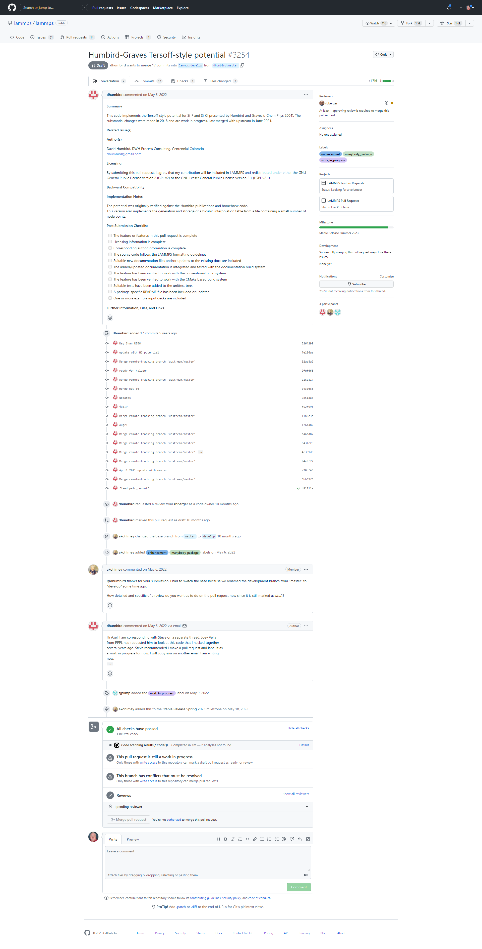
Pull Requests (or Merge Requests)
A mechanism for proposing changes in a git repository
“I would like to contribute this set of commits to your repository”
In practice: a set of changes from one branch being proposed to merge into another branch
Why? Implement a new feature. Fix a bug. Etc.
In practice, even useful for lone developers
Hosting environments like GitHub or Gitlab support having an online conversation among developers about the PR/MR
In many projects, independent review of PRs/MRs is required before the are accepted (“merged”) a.k.a. “code review”
This is a proven approach to increase the quality of code
A request to merge 17 commits from the master branch of dhumbird’s repository (a copy a.k.a. “fork” of the lammps repo) into the develop branch of the lammps repo.
The beginning of a pull request to the LAMMPS repository

Slide 17
The Rest of the Pull Request
Conversation about the PR
The commits
Status information (tests, reviews, etc.)

Slide 18
Git Workflows
A set of rules/procedures for how branches are used in a git repository…
…to help the developers fulfill certain goals
Examples of some git workflow rules/goals
Key questions in designing a git workflow
The main branch should always be deployable (i.e., always passing the test suite)
New features or bug fixes are developed in a separate branch and merged when they’re complete and tested
A new branch is made for each new release, and bug fixes for that release are done on the release branch
What’s stable, under what conditions?
What’s tested?
How long does a branch live?
Infinite – e.g., main, development, stable
Short term – e.g., features, fixes
Longer period – e.g., releases
What are the requirements for moving changes from one branch to another?
Design/adopt a workflow that fits your projects needs. And revise as needed. Don’t feel that you have to start with something very complex!

Slide 19
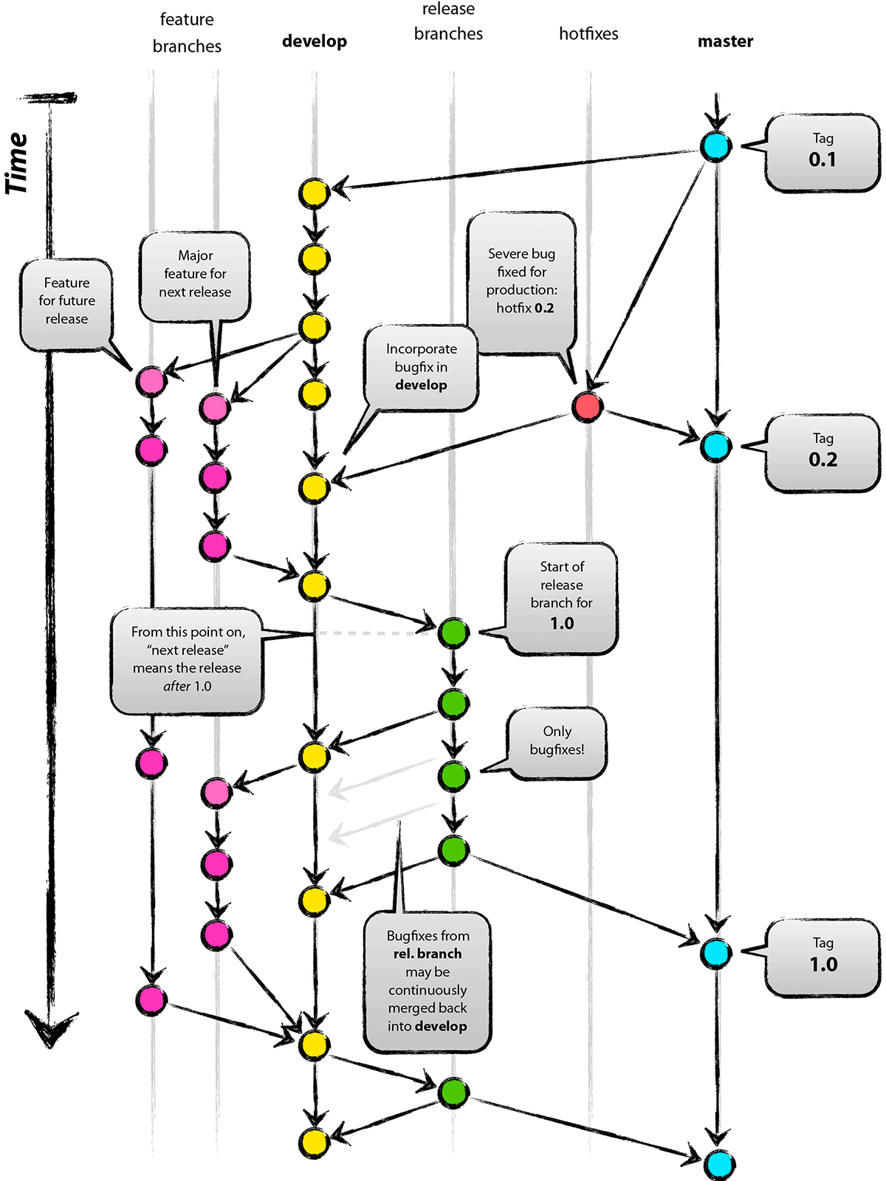

Git Flow
Full-featured workflow
Increased complexity
Designed for SW with official releases
Feature branches based off of develop
Git extensions to enforce policy
How are develop and main synchronized?
Where do merge conflicts occur and how are they resolved?
main
Author: Vincent Driessen
Original Blog: https://nvie.com/posts/a-successful-git-branching-model/
License: Creative Commons
Notes:
Go through quickly shows complexity and designed for SW with official releases add why use this

Slide 20
GitHub Flow
http://scottchacon.com/2011/08/31/github-flow.html
Published as viable alternative to Git Flow
No structured release schedule
Continuous deployment & continuous integration allows for simpler workflow
Key Ideas
All commits in the main branch are deployable
Base feature branches off of main
Push local repository to remote constantly
Open Pull Requests early to start dialogue
Merge into main after Pull Request review
Notes:
Go through quickly – point out No structured release schedule, continuous integration, simpler add why use this

Slide 21
GitLab Flow
https://docs.gitlab.com/ee/topics/gitlab_flow.html
Published as viable alternative to Git Flow & GitHub Flow
Semi-structured release schedule
Workflow that simplifies difficulties and common failures in synchronizing infinite lifetime branches
Key Ideas
main branch is staging area
Mature code in main flows downstream into pre-production & production infinite lifetime branches
Allow for release branches with downstream flow
Fixes made upstream & merged into main.
Fixes cherry picked into release branch
Notes:
Go through quickly Use this if the release schedule is not as structured

Slide 22
Current Trilinos Workflow
https://trilinos.github.io/
Test-driven workflow
Feature branches start and end with develop
All changes to develop must come from GitHub pull requests
Feature branches are merged into develop only after passing pull request test suite
Change sets from develop are tested daily for integration into main
Workflow designed so that
All commits in main are in develop
Merge conflicts exposed when integrating into develop
Merge conflicts never occur when promoting to main
main
develop
develop -> main testing
Pull request testing
Issue 1
Issue 2
Notes:
From the website: The Trilinos Project is a community of developers, users and user-developers focused on collaborative creation of algorithms and enabling technologies within an object-oriented software framework for the solution of large-scale, complex multi-physics engineering and scientific problems on new and emerging high-performance computing (HPC) architectures.
Trilinos is also a collection of reusable scientific software libraries, known in particular for linear solvers, non-linear solvers, transient solvers, optimization solvers, and uncertainty quantification (UQ) solvers.

Slide 23
Current Open MPI Workflow
Workflow designed so that
Support two most recent releases
Issues are addressed on all applicable branches
All PR’s reviewed by at least one core developer
Main and supported branches work at all times
Developers work on main or feature branches depending on complexity of the changes
Testing
CI testing on PR’s for any branch using Jenkins (limited set of compilers, hardware, tests)
Nightly testing on all branches using community-built MTT framework (more complex set of compilers, hardware, tests)
Additional testing for release candidates
https://www.open-mpi.org
Versioning:
Major versions - break compatibility
Minor versions – visible
Releases correct issues
main
Upcoming release (if exists)
Latest supported release
Previous supported release
Issue 1
Issue 2
Notes:
A High Performance Message Passing Library

Slide 24
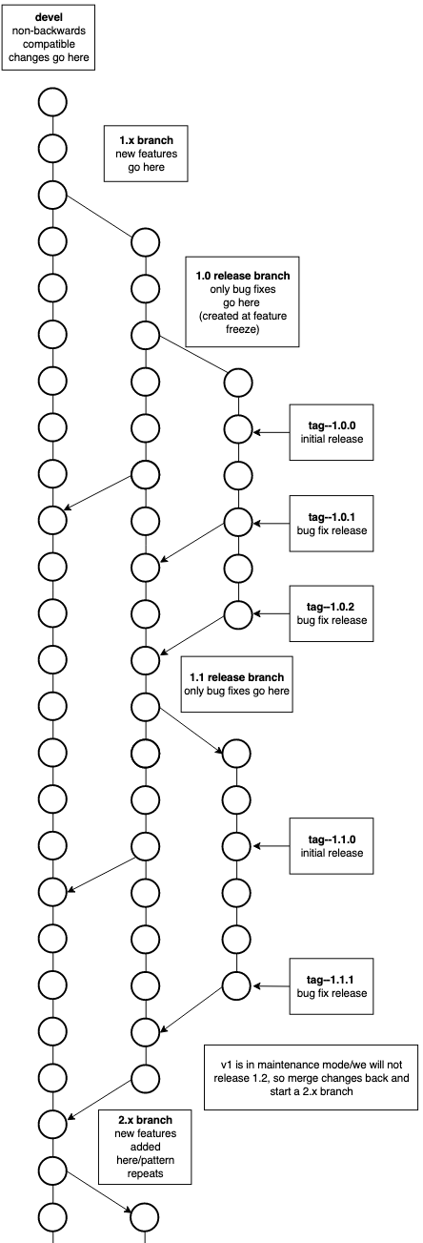
Current FleCSI Workflow
https://flecsi.github.io/flecsi
Versioning:
Incompatible - devel branch breaks compatibility with previous versions
Feature (1, 2 …) named for major version
Release - (1.x, 2.x …) named for major.minor version, correct issues, tags used for bug fixes.
Workflow designed so that
All supported branches work at all times
Merge Requests are tested and reviewed
Testing
Customized unit-testing framework based on Google Test
Special gitlab-ci branch - images and configuration files
Notes:
FleCSI is a compile-time configurable framework designed to support multi-physics application development for current and emerging HPC systems.
In the diagram there is a 1.x branch only for new releases, an initial 1.0 release branch with tag 1.0.0 as the initial release and tags 1.0.1, 1.0.2 for bug fixes, when 1.1 feature is release again an initial tag 1.1.0, then bug fix release tags 1.1.1 & 1.1.2 etc. Once a major version goes into maintenance mode and a new major feature branch begins; in this case 2.x and like branches and tags are created for 2.x

Slide 25
A Summary of Best Practices for Version Control
USE IT!
Commit and push frequently
Less chance of losing your work
Makes your work visible to others
Pull frequently
Keeps your version closer to the upstream version
Use branches and workflow rules judiciously
Short-lived branches for development and bug fixes
Long-lived/infinite lifetime branches for special versions (e.g., for particular hardware platforms)
Use tags to associate specific versions of the code with specific experiments
Use pull/merge requests to manage changes
One PR should cover one separable piece of work
If PRs get too large, break them into smaller pieces

Slide 26
Learning More About Git
BSSw.io’s “revision control” topic
https://bssw.io/items?topic=revision-control
A Tutorial and Reference Collection for Git
https://bssw.io/items/a-tutorial-and-reference-collection-for-git
Want to Start Getting Git Right?
https://bssw.io/items/want-to-start-getting-git-right
Critical Beginner Git Usage Tips
https://bssw.io/items/critical-beginner-git-usage-tips

Slide 27
Code Review – What Peer Code Review Can Provide
Allows discussion of proposed changes
Iterations for better code
Discussions and reviewing allow more understanding of the code
Ensures requested change/feature met
Evaluates impact of the change
Breakages
Interactions with other parts of code
Ensures coding guidelines are met
Improves practices by learning
About other parts of the code
Helpful coding techniques by others
Blog: How to code review in a Pull Request
Author: Hugo Sousa - March 17, 2021
https://blog.codacy.com/how-to-code-review-in-a-pull-request/
Notes:
Transition – How does code review fit into this process?

Slide 28
Code Review - Improvement and Practices
Helpful practices for scientific research software
Make code review process formal with structured guidelines
Allocate sufficient time in the development process to perform code review
Try to ensure at least one science review and one technical review
Timely reviews - provide quick feedback to incoming review requests
Train reviewers on how to phrase good feedback
Train developers to accept comments to improve their code
Include automatic code review tool and train reviewers in best use practice of the tool
Investing in Code Reviews for Better Research Software (2022-10-12)
Presenters : Thibault Lestang, Dominik Krzemiński and Valerio Maggio
https://ideas-productivity.org/events/hpc-best-practices-webinars/#webinar068
Testing and Code Review Practices in Research Software Development (2020-09-09)
Presenter: Nasir Eisty
https://ideas-productivity.org/events/hpc-best-practices-webinars/#webinar044

Slide 29
Coding Conventions (a.k.a. Coding Standards)
What?
Formatting guidelines
Naming guidelines
Other general coding guidelines
E.g., don’t repeat yourself (DRY)
Paradigm- and language-specific guidelines
E.g., OO design or OpenMP guidelines
Why?
Improve the understandably and maintainability of the codebase
Increase productivity in development
Reduces choices developer needs to make
Foster shared ownership of the codebase
Streamline and improve peer code reviews
Conventions reduce arguments over aesthetics
Automation reduces the issues the code review needs to address
How?
Team needs to agree to impose conventions
What matters is having and enforcing them
Not exactly what those rules are – avoid endless arguments about aesthetic preferences
Many large projects/organizations have adopted conventions and documented them (see Wikipedia page)
Where possible use a tool to enforce coding conventions
Automatically – you don’t have to spend time on it
Dispassionately – its not personal when a bot tells you
Tools are available for most languages (see Wikipedia page and Google searches)
Combine with peer code review for the conventions that aren’t easily automatable
See https://bssw.io/items/coding-conventions and references therein,
especially https://en.wikipedia.org/wiki/Coding_conventions

Slide 30
Documentation
Documentation of all kinds is an investment for your future self as well as collaborators and users
User-facing documentation
Build/install guide, quick start guide, in-depth user guide, example input and outputs, tutorials
Developer-facing documentation
Prioritize what would most help a newcomer to your project get up to speed and can’t be found in the code itself
Requirements
Functional – e.g., scientific capabilities
Non-functional – e.g., performance, robustness, extensibility, etc.
Design and architecture – why is important
Coding conventions, project workflows
In-code comments should provide information you can’t get from simply reading the code
Good code review topic
Use tools and documentation builders to simplify creating and publishing documentation
Doxygen for code structure
Sphinx started for Python, but general
Readthedocs.org to publish documentation
Markdown or RST are popular and simple markup languages that many doc tools can work with
Always keep documentation current
“I’ll do it later” usually doesn’t happen
Consider requiring documentation updates as part of any PR and check for it in code review (partly automatable)
Consider using an approach that allows each code version to have distinct documentation
Avoids decisions about when to update docs

Slide 31
Issue Tracking
An issue is a request for action by a developer community
Bug report (internal or external)
New feature request (internal or external)
Request for help (mostly external)
Often leads to bug report or feature request
Creating issues is a kind of documentation
Provides visibility to all interested parties
Helps ensure important things are not forgotten or lost
Useful even to lone developers
Also assist with task prioritization, scheduling, and management
Useful even to lone developers
Issues often “start” in email, but shouldn’t remain there
Personal email is not visible to others
Mailing list doesn’t support dealing with issues in an organized and thoughtful way
Hosting services (e.g., GitHub, Gitlab) provide a purpose-built issue tracking tool with each repository
Conversations, attachments, etc.
Updates as work progresses
Templating to help ensure good quality issue submissions
Labels to help categorize issues
Assignment of issues to developers
Linking of issues to PRs that resolve them

Slide 32
Dealing with Issues
Eliciting “good” issue submissions
Addressing issue submissions
What is minimum information needed?
Software version
Platform
Configuration (e.g., build options, etc.)
Min reproducible case (where applicable)
What did you try? What was the result? What did you expect?
Severity
Workarounds
One issue submission should cover one thing
Multiple issues should be in separate submissions
Implement a template to guide submissions
Different templates for different types of issues
E.g., bug reports vs feature requests
Triage the submission
Bug or feature request?
How significant is it? How urgent is a response?
For bugs, you need to be able to reproduce the problem
You may have to ask additional questions
Label the issue according to your team standards
Discuss with your team
Is the feature within the vision? Is it a bug?
Prioritize/schedule
Assign tasks
Document the plan in the issue
Work the Issue
Document progress in the issue
Create PR with fix/new feature
Maybe ask submitter to confirm fix/feature
Document resolution, link to PR, note version(s)

Slide 33
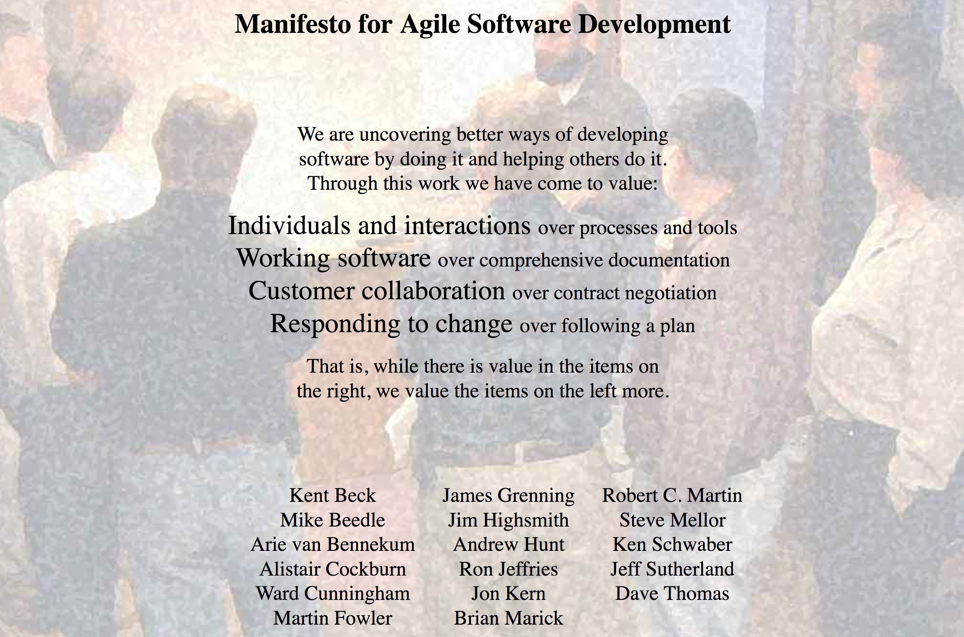
Agile Software Development
http://agilemanifesto.org/
Notes:
4 critical components above the red box. The left hand side is emphasized over the right such as Working Software. Although comprehensive documentation is important, Working Software would take precendence. Look over the manifesto and the four main components.

Slide 34
What Agile Isn’t, and Why We Use It
Agile is not a software development lifecycle model
Agile is not an excuse to do sloppy work
It is not “I don’t write documentation”
It is not “I don’t do formal requirements, design, or really test…”
Some people consider agile to be synonymous with Scrum
From Atlassian: Scrum is a framework that helps teams work together
Scrum is Agile, Agile is not (only) Scrum
A square is a rectangle, not all rectangles are squares
Agile fits the research experience better than heavier-weight approaches
Aligns more naturally with how scientific progress is made
Agile is well-suited for scientific software efforts (when tailored correctly)
Works well for small teams
Provides meaningful, beneficial structure that promotes
Productivity
Productization
Sustainability
Flexibility in requirements
Communication

Slide 35
Getting Started with Agile
Agile principles are not hard and fast rules
Try adopting a few Agile practices
Following a rigid, ill-fit framework usually leads to failure
Kanban is a good starting framework
Follow basic principles
Add practices when advantageous
Better than removing elements from Scrum
Task: Have Eureka moment by Tuesday.
Scrum
Notes:
Pick a practice to try and if it works for your team add it to your processes. Easier to get started with Kanban and add practices
Add practices when needed such as for more rigor/process to keep things under control

Slide 36
Basic Kanban
Backlog | Ready | In Progress | Done
Any task idea Trim occasionally Source for other columns | Task + description of how to do it. Could be pulled when slot opens. Typically comes from backlog. | Task you are working on right now. The only Kanban rule: Can have only so many “In Progress” tasks. Limit is based on experience, calibration. Key: Work is pulled. You are in charge! | Completed tasks. Record of your life activities. Rate of completion is your “velocity”.
Notes:
Ready column is not strictly required, sometimes called “Selected for development”.
Other common column: In Review
Can be creative with columns:
Waiting on Advisor Confirmation
Under review
Blocked
Notes:
You may have other columns In Review etc. you can be as creative as you want. Design it how it works for you.

Slide 37
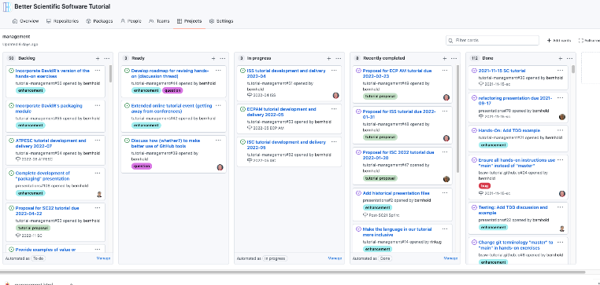
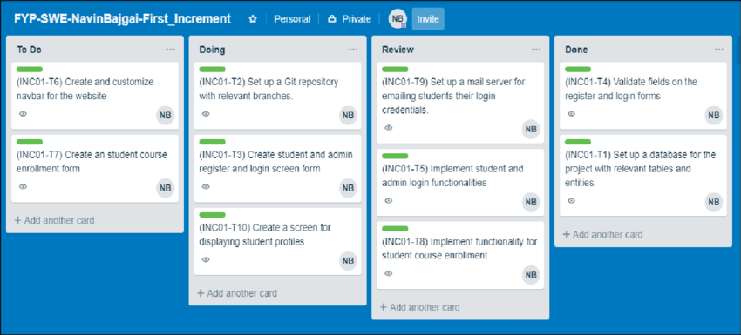
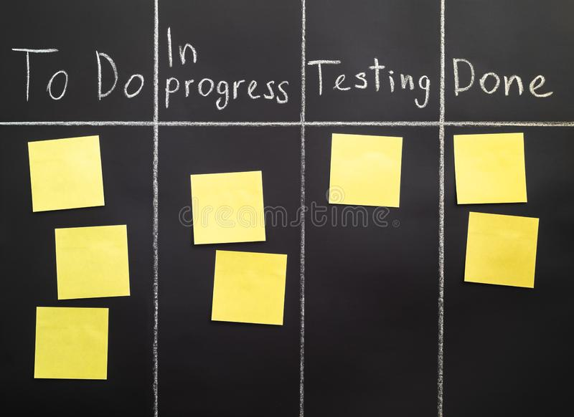
Kanban Tools
Wall, whiteboard, blackboard: Basic approach.
Software, cloud-based:
Trello, JIRA, GitHub or GitLab Issues & Project Boards
Many more.
Trello (browser, Android, iPhone, iPad).
Can add, view, update, anytime, anywhere.
Different boards for different contexts
Effective when people are split on multiple projects

Slide 38
Kanban Principles
Limit number of “In Progress” tasks
Must be tuned by each team
Optimize “flexibility vs swap overhead” balance. Prevent overcommitting
Freeway traffic analogy:
Does traffic flow best when fully packed? No
Same thing with your effectiveness
Common starting point: 2n-1 tasks where n = # team members
Have another task to do when you’re blocked
Minus one to encourage helping someone else with a challenging task
Productivity improvement
Productivity weakness exposed as bottleneck. Team must identify and fix the bottleneck
Effective in R&D setting. Avoids a deadline-based approach. Deadlines are dealt with in a different way
Spend time consulting board regularly
Brings focus
Enables reflection, retrospection
Use slack time effectively
Steers towards previously started tasks
When you get out of the habit, start up again
Notes:
Consider the cost of context switching, Kanban is good at exposing bottlenecks, If you have a column like “Waiting for Review or Blocked” that is full you can easily see the bottleneck.
Kanban also naturally supports researcher/developers who might be part-time on multiple projects (scrum tends to assume people are full time on one project)

Slide 39
Advantages of Code/Project Hosting Platforms
These platforms bring together many useful tools for software or document development
E.g., GitHub, GitLab, BitBucket, etc.
Useful for teams or individuals
Repositories may be public or private
May be hosted in the cloud or locally
Professionally maintained, backed up, etc. (hopefully)
Tools include: version control, issue tracking, pull/merge requests, Kanban boards, wikis, discussion boards, automated actions (e.g., continuous integration testing), website hosting, APIs for further automation and integration with third-party services/tools

Slide 40
Recap and Closing

Slide 41
Science through computing is, at best, as credible as the software that produces it!
Notes:
Fundamental message

Slide 42
Example 1: Best Practices for Scientific Computing (1/2)
Wilson, et al., (2014) https://doi.org/10.1371/journal.pbio.1001745
Write programs for people, not computers.
A program should not require its readers to hold more than a handful of facts in memory at once.
Make names consistent, distinctive, and meaningful.
Make code style and formatting consistent.
Let the computer do the work.
Make the computer repeat tasks.
Save recent commands in a file for re-use.
Use a build tool to automate workflows.
Make incremental changes.
Work in small steps with frequent feedback and course correction.
Use a version control system.
Put everything that has been created manually in version control.
Don't repeat yourself (or others).
Every piece of data must have a single authoritative representation in the system.
Modularize code rather than copying and pasting.
Re-use code instead of rewriting it.
Plan for mistakes.
Add assertions to programs to check their operation.
Use an off-the-shelf unit testing library.
Turn bugs into test cases.
Use a symbolic debugger.

Slide 43
Example 1: Best Practices for Scientific Computing (2/2)
Wilson, et al., (2014) https://doi.org/10.1371/journal.pbio.1001745
Optimize software only after it works correctly.
Use a profiler to identify bottlenecks.
Write code in the highest-level language possible.
Document design and purpose, not mechanics.
Document interfaces and reasons, not implementations.
Refactor code in preference to explaining how it works.
Embed the documentation for a piece of software in that software.
Collaborate.
Use pre-merge code reviews.
Use pair programming when bringing someone new up to speed and when tackling particularly tricky problems.
Use an issue tracking tool.

Slide 44
Example 2: Good Enough Practices in Scientific Computing (1/2)
Wilson, et al., (2017) https://doi.org/10.1371/journal.pcbi.1005510
Data management
Save the raw data.
Ensure that raw data are backed up in more than one location.
Create the data you wish to see in the world.
Create analysis-friendly data.
Record all the steps used to process data.
Anticipate the need to use multiple tables, and use a unique identifier for every record.
Submit data to a reputable DOI-issuing repository so that others can access and cite it.
Manuscripts (out of order to save space)
Write manuscripts using online tools with rich formatting, change tracking, and reference management.
Write the manuscript in a plain text format that permits version control.
Software
Place a brief explanatory comment at the start of every program.
Decompose programs into functions.
Be ruthless about eliminating duplication.
Always search for well-maintained software libraries that do what you need.
Test libraries before relying on them.
Give functions and variables meaningful names.
Make dependencies and requirements explicit.
Do not comment and uncomment sections of code to control a program's behavior.
Provide a simple example or test data set.
Submit code to a reputable DOI-issuing repository.

Slide 45
Example 2: Good Enough Practices in Scientific Computing
Wilson, et al., (2017) https://doi.org/10.1371/journal.pcbi.1005510
Collaboration
Create an overview of your project.
Create a shared "to-do" list for the project.
Decide on communication strategies.
Make the license explicit.
Make the project citable.
Project organization
Put each project in its own directory, which is named after the project.
Put text documents associated with the project in the doc directory.
Put raw data and metadata in a data directory and files generated during cleanup and analysis in a results directory.
Put project source code in the src directory.
Put external scripts or compiled programs in the bin directory.
Name all files to reflect their content or function.
Keeping track of changes
Back up (almost) everything created by a human being as soon as it is created.
Keep changes small.
Share changes frequently.
Create, maintain, and use a checklist for saving and sharing changes to the project.
Store each project in a folder that is mirrored off the researcher's working machine.
Add a file called CHANGELOG.txt to the project's docs subfolder.
Copy the entire project whenever a significant change has been made.
Use a version control system.

Slide 46
Software Engineering Advice Often Needs Adaptation for Scientific Software
The CII Best Practices are a good example of software engineering advice “in the wild”
Experiences reported in the wild often don’t consider the special nature of scientific software
But that doesn’t mean we should ignore all of the software engineering experience
Many useful concepts, approaches, and tools we can just adopt
Some approaches may need to be adapted to work for scientific software
Find out how colleagues have addressed the challenges you’re facing
Probably you will find multiple ways
In the end, some approaches may not work well
Don’t be afraid to experiment with adaptations
Consider using the PSIP process

Slide 47
How Much (Time, Effort) Should I Spend on Software Engineering?
Your project should include “just enough” software engineering so that you can meet your short-term and longer-term scientific goals effectively
The most important beneficiary of your software engineering efforts is your future self!

Slide 48

Continual, Incremental Software Process Improvement
Target: your project should include “just enough” software engineering so that you can meet your short-term and longer-term scientific goals effectively
Identify your team’s “pain points” in your software development processes
Help: RateYourProject assessment tool: https://rateyourproject.org/
Set a goal for something to improve
Target processes and behaviors, not just tasks
Pick something that you can address in a few months that will give you a noticeable benefit
Agree on a plan to address it, identify markers of progress and what is “done”
Write them down
Help: Progress tracking card examples: https://bssw-psip.github.io/ptc-catalog/catalog
Work your plan, track your progress
When you are done, celebrate…
…then pick a new pain point to address
Old Process
New Process
Cost
Start
Progress
Finish
The new process costs something to implement, but it pays off over time
Productivity and Sustainability Improvement Planning https://bssw.io/psip
A goal of BSSw.io is to provide resources for improving your software processes. If you find useful resources that aren’t on BSSw.io, consider contributing. Its easy and quick.

Slide 49
Help is Not Far Away!
Links within this presentation
https://bssw.io
If you know of useful resources that we don’t have, tell us! (via an issue)
Sign up for monthly digest: https://bssw.io/pages/receive-our-email-digest (1 msg/mo, BSSw Fellowship info)
BSSw tutorials (videos of recent tutorials available)
HPC Best Practices webinar series (> 70 webinars)
Sign up for mailing list: http://eepurl.com/cQCyJ5 (1-2 msgs/mo)
Software Sustainability Institute (UK)
Blogs, events, guides, etc.
US-RSE
Blogs, events, webinars, community
Google search
Watch for coming software sustainability/stewardship initiatives from DOE

